Slide 1


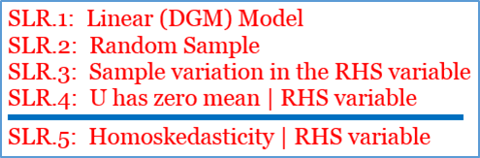
SLR Models: Estimation

Slide 2
SLR Models Estimation: Those OLS estimates

Slide 3
ex Post estimates v. ex Ante estimators

Slide 4
SLR Models Estimation: Let’s review notation!

Slide 5
Those SLR Conditions: SLR.1-SLR.4

Slide 6
PRFs and Linear Estimators

Slide 7
OLS Estimators are Unbiased! Who saw this coming?

Slide 8

But B₁ is not Alone!

Slide 9
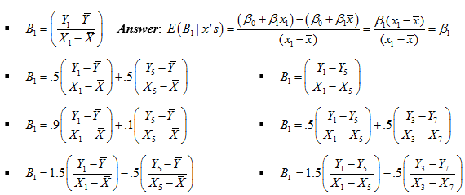
So many LUEs! Test your understanding!

Slide 10
OLS Estimators (B₀ and B₁) have Variances I

Slide 11
The BLUE Challenge:
Which LUE has the smallest variance?

Slide 12
SLR.5: Homoskedasticity

Slide 13
Heteroskedasticity Example: Real Estate valuation

Slide 14
OLS Estimators (B₀ and B₁) have Variances II

Slide 15
MSE/RMSE and the Standard Error of the Regression

Slide 16
MSE is an Unbiased Estimator of var(U|x)

Slide 17
Standard Errors of B₁: Estimates of sd(B₁)

Slide 18
Onwards to Gauss, Markov, BLUE… and Inference!

